Slide 1

Customer Shopping Behavior Analysis
Uncovering insights from 3,900 purchases to guide strategic decisions

Slide 2
DATASET OVERVIEW
The Foundation
3.9K
18
50
Total Purchases
Data Points
Locations
Transactions analyzed
Features per customer
Geographic coverage
Key Features Captured
Customer demographics and subscription status
Purchase details across categories and seasons
Shopping behavior and review ratings
Discount and promo code usage

Slide 3

DATA PREPARATION
Python Analysis Pipeline
01
Data Loading & Exploration
Imported dataset, checked structure and summary statistics
02
Missing Data Handling
Imputed 37 missing review ratings using category medians
03
Feature Engineering
Created age groups and purchase frequency metrics
04
Database Integration
Loaded cleaned data into MySQL for SQL analysis

Slide 4
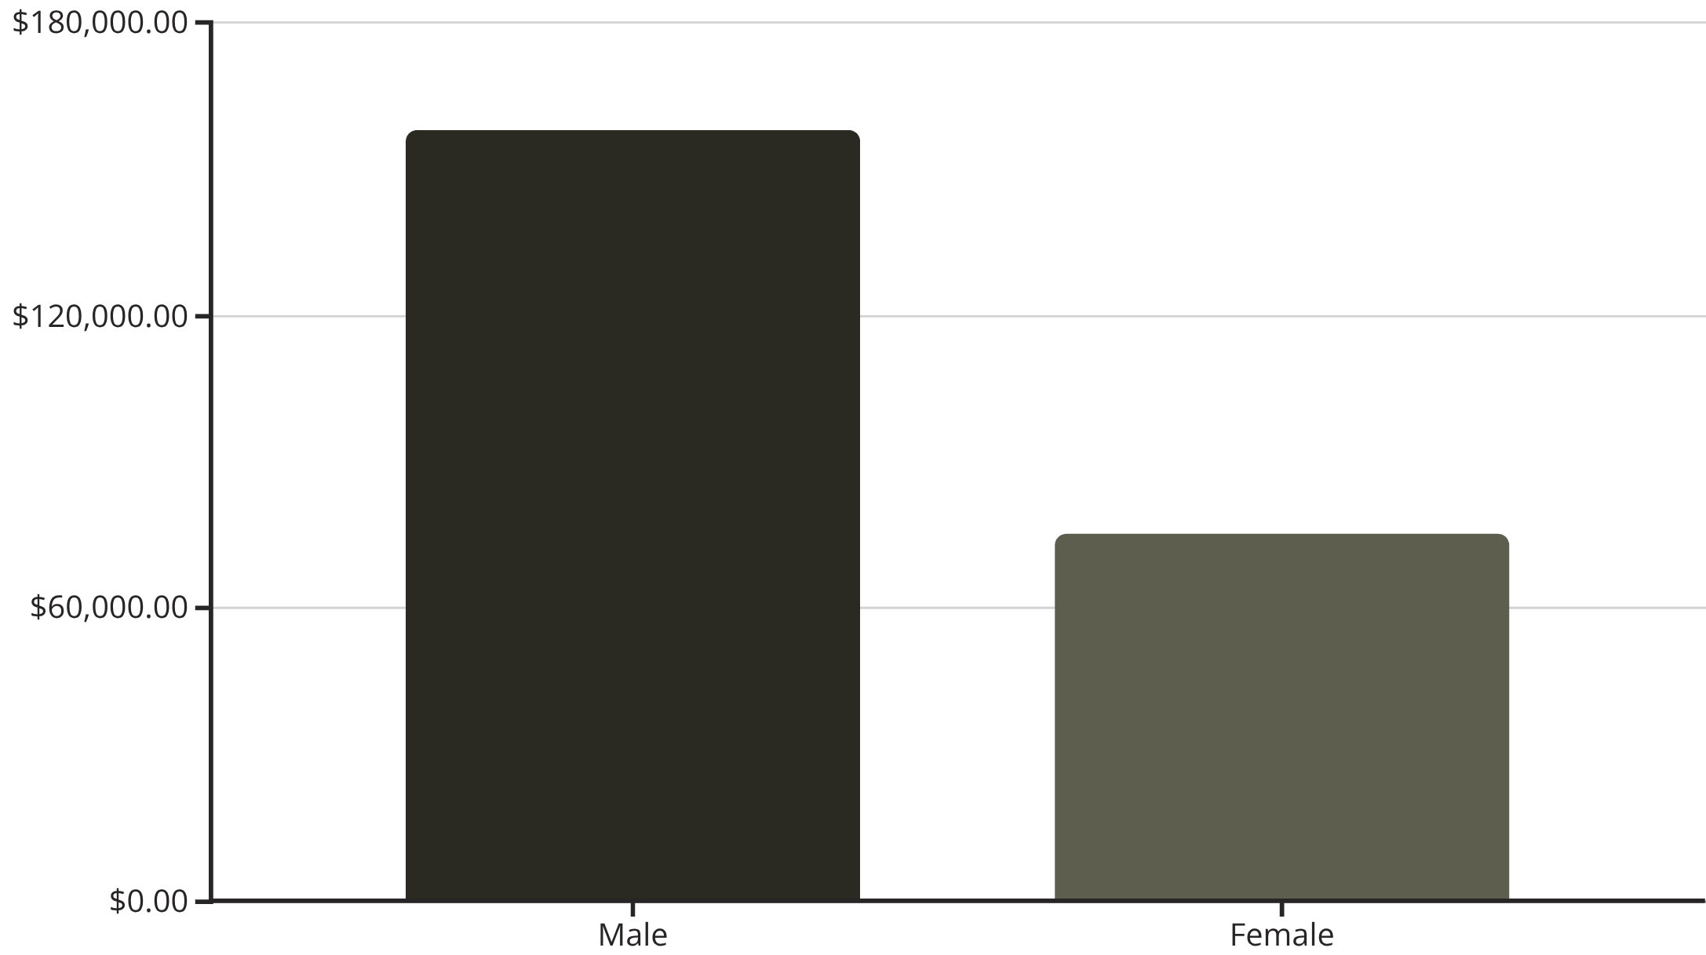
Revenue by Gender
Male Customers Drive Revenue
Male customers generate 68% of total revenue, more than double female customer spending.
This presents opportunities for targeted marketing campaigns.

Slide 5


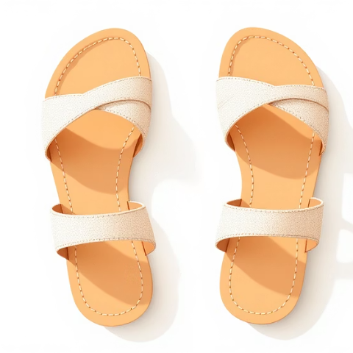



TOP PERFORMERS
Product Excellence
Gloves
Sandals
Boots
Hat
Rating: 3.86
Rating: 3.84
Rating: 3.82
Rating: 3.80
Skirt
Rating: 3.78

Slide 6
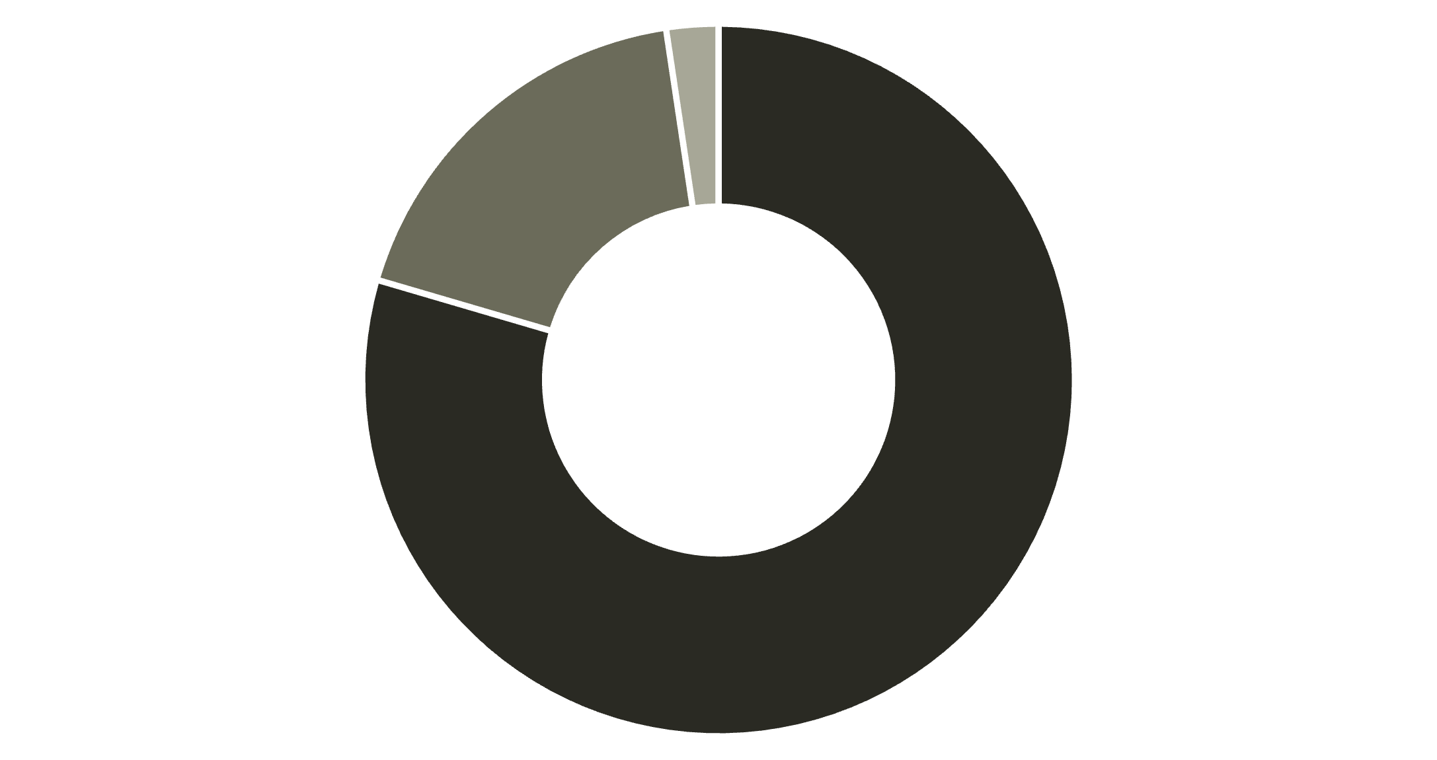
Customer Segmentation Insights
Loyal Customers
80% of customer base with strong repeat purchase behavior
Returning Buyers
18% showing positive engagement patterns
New Customers
Loyal
Returning
New
2% representing growth opportunity

Slide 7


Subscription Status Analysis
27%
73%
Subscribers
Non-Subscribers
1,053 customers with active subscriptions
2,847 customers without subscriptions
Key Finding
Repeat Buyers
Subscribers and non-subscribers show similar average spend ($59.49 vs $59.87), but subscribers represent untapped revenue potential through retention.
Of customers with 5+ purchases:
958 are subscribers
2,518 are not subscribed
Massive opportunity to convert loyal buyers into subscribers.

Slide 8
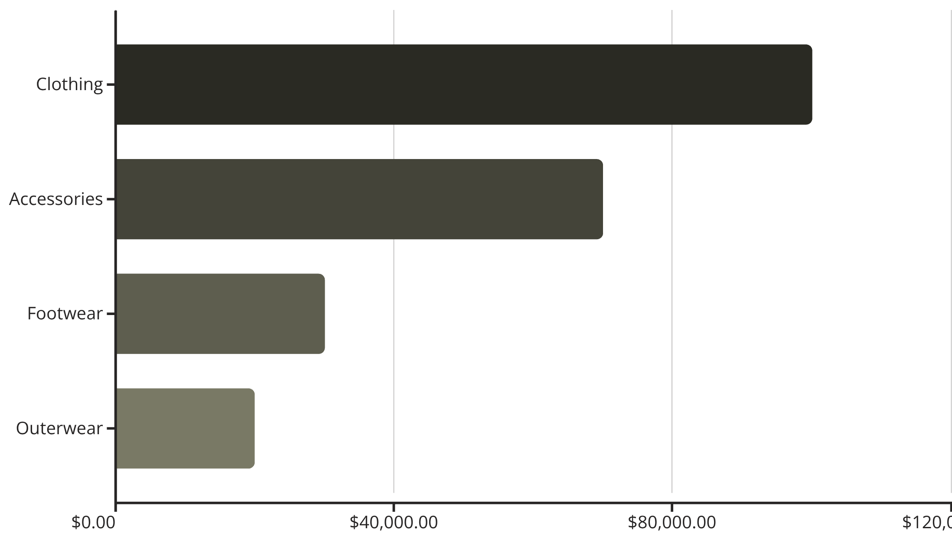
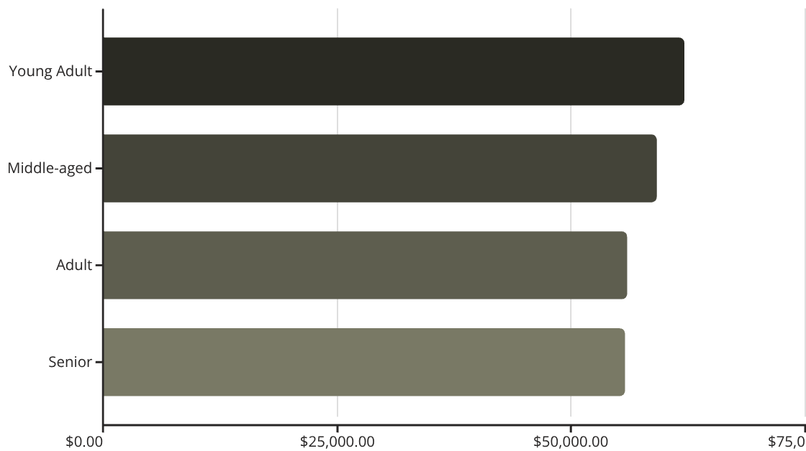
REVENUE BREAKDOWN
Category & Age Group Performance
Revenue by Category
Revenue by Age Group

Slide 9

Discount Strategy Insights
High-Value Discount Users
Discount-Dependent Products
Shipping Impact
Express shipping users spend $2 more on average than standard ($60.48 vs $58.46)
839 customers used discounts but still spent above average ($60+)
Hats (50%), Sneakers (49.7%), Coats (49%) show highest discount rates

Slide 10




ACTION PLAN
Strategic Recommendations
Boost Subscriptions
Loyalty Programs
Promote exclusive benefits to convert 2,518 repeat buyers into subscribers
Reward repeat buyers to strengthen the 80% loyal customer base
Optimize Discounts
Targeted Marketing
Balance sales boosts with margin control on discount-dependent products
Focus on young adults, male customers, and express shipping users

